Slide 1
Syllabus Discussion

Slide 2
Synonyms in Isolation and Context
Practice
Antonyms in Isolation and Context
Practice
Common Confusable
Practice
Cloze Passage
Practice
Word Analogy
Practice
Sentence Completion
Practice

Slide 3
Spotting Errors – Level I
Practice
Spotting Errors – Level II
Practice
Spotting Errors – Level II
Practice
Sentence Correction-Type I & II
Practice
Sentence Correction-Type III & IV
Practice
Sentence Correction-Type V& VI
Practice

Slide 4
Critical Reasoning – Weakening
Practice
Critical Reasoning – Inference
Practice
Critical Reasoning – Conclusion
Practice
Critical Reasoning - Explain the paradox
Practice
Critical Reasoning – Miscellaneous
Practice
Critical Reasoning – Miscellaneous
Practice

Slide 5
Reading Comprehension – Main Idea
Practice
Reading Comprehension – Tone
Practice
Reading Comprehension – Inference
Practice
Reading Comprehension – Summary
Practice
Reading Comprehension – Conclusion
Practice
Reading Comprehension – Miscellaneous
Practice

Slide 6
Para Jumble-Type I
Practice
Para Jumble-Type II
Practice
Para Jumble-Type III
Practice
Para Completion
Practice
Para Completion
Practice
Para Summary
Practice

Slide 7
What is the need for communicating or mastering English?

Slide 8
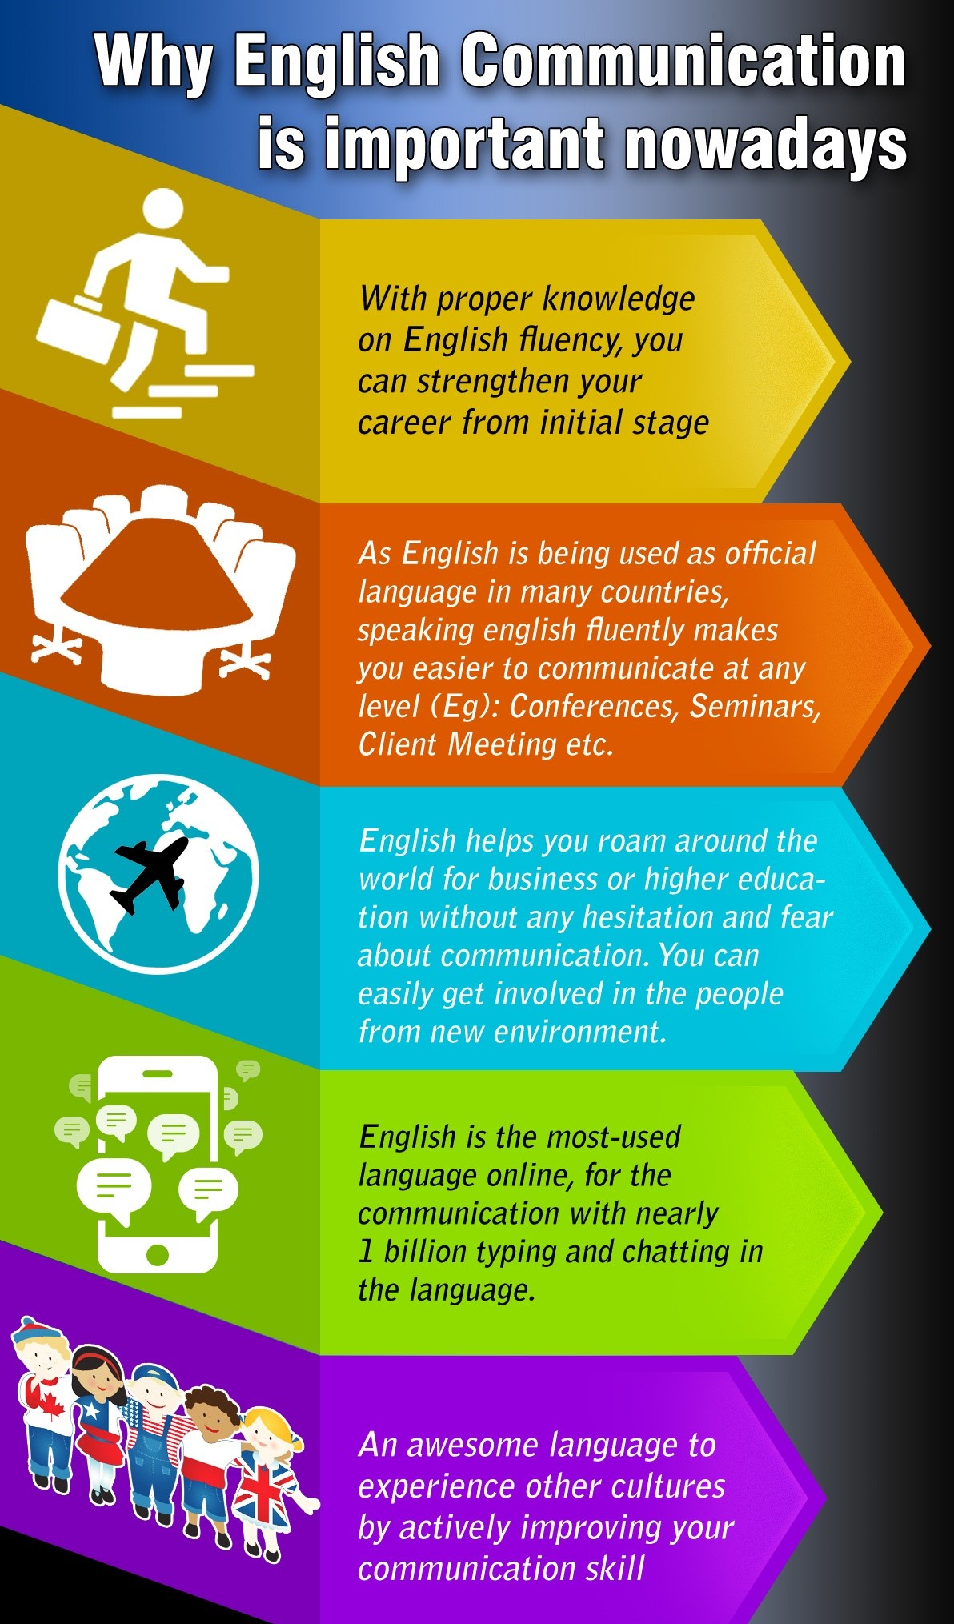
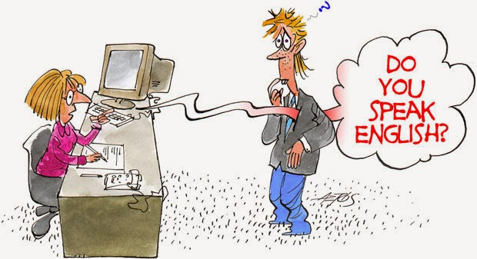

Slide 9
Different rounds in an Interview
Round 1
Aptitude
Verbal Ability
Technical questions
Round 2
Group discussion
Round 3
HR interview

Slide 10
Why Corporates test your verbal ability?

Slide 11
To find out your proficiency in
1. Communication
2. Reasoning ability
3.Inference of the context
4.Reading Comprehension
5.Critical thinking
6.Vocabulary

Slide 12
What is the meaning of the word Vocabulary?
Vocabulary is your word bank . Having an extended vocabulary helps one to articulate ones thoughts clearly, to communicate fluently and to meet the challenge in competitive exams

Slide 13
How to build your Vocabulary?
By reading
By listening
By learning root words
By using a Thesaurus
By looking up at words you did not know
By doing Word Puzzle

Slide 14
1100
The Oxford dictionary added 1100 new words to the English Dictionary in the year 2018

Slide 15
Example of new words
1. Awesomesauce (adjective)
When something is extremely good, feel free to call it awesomesauce.
2. Weak sauce
The opposite, something extremely bad or disappointing, would be weak sauce.
3.Hangry (adjective)
We’ve probably all been hangry before: you simply combine anger with hunger to describe that familiar feeling when you’re crabby and in a bad mood because you need something to eat asap.

Slide 16
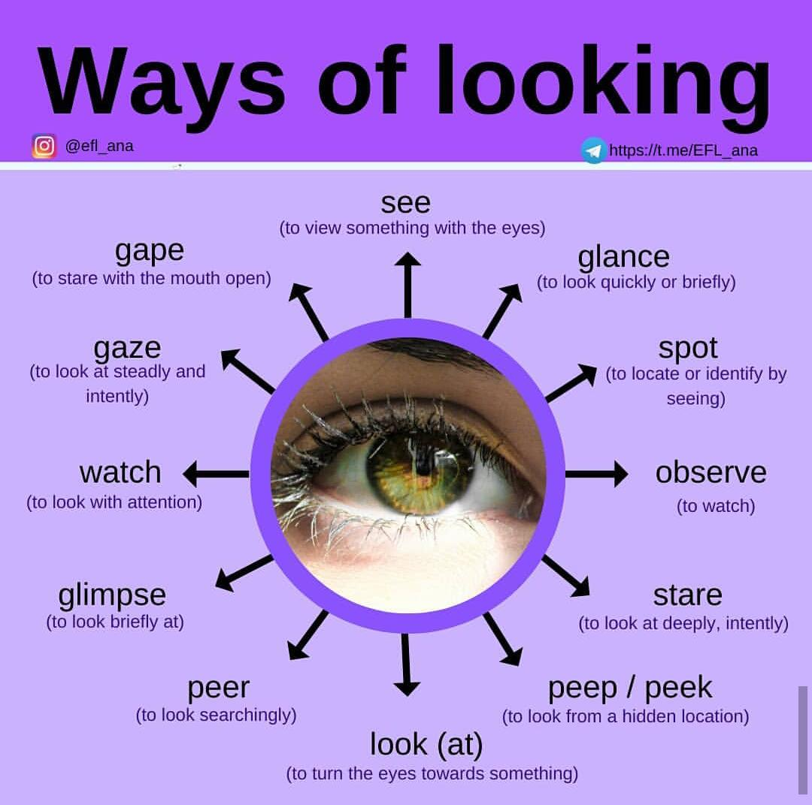
Why is it required?

Slide 17
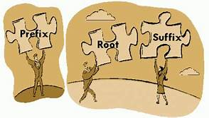
How to Crack it?
Prefix
Root Words
Suffix
Reduce a complex term to simple word

Slide 18
Learning new words through etymology
What does etymology mean ?
It means the origin of the word . English is a derived language and it has root words from Greek, Latin &French.
Learning root words will help us to comprehend words related to it, and thereby increase our vocabulary.

Slide 19
PREFIX
A prefix is a word part that is placed in front of a base word.
Common prefixes include pre, bi, and anti.
A prefix usually changes the meaning of the base word.

Slide 20
Prefixes of Negation
Un-
In-
Im-
De-
Mis-
Non-
Mal-
Unachievable, Inaccurate, Impossible, deactivate, misaligned, nonprofit ,Malfunction.

Slide 21
Prefixes of Attitude
Anti-
Counter-
Contra-
Pro-
Co-
Anti – against antisocial . Pro –for pro –democracy ,Co –together coexist cooperate ,Counter- against counter terrorism, Contra –against Contradict

Slide 22
Prefixes of Number
Uni-
Bi-/di-
Tri-
Deci-
Multi-

Slide 23
Prefixes Emphasising Degree
Super-
Sub-
Hyper-
Mini-
Over-
Out-
arch
Super –more than better, Hyper-Extreme, Mini – Small, Over-more than normal ,Out- to a greater degree outdo, arch- highest archenemy. archbishop. Sub-below ,less than Subway, Submarine

Slide 24
Prefixes of location or direction
Pre-
Post-
Trans-
Notes:
Pre

Slide 25
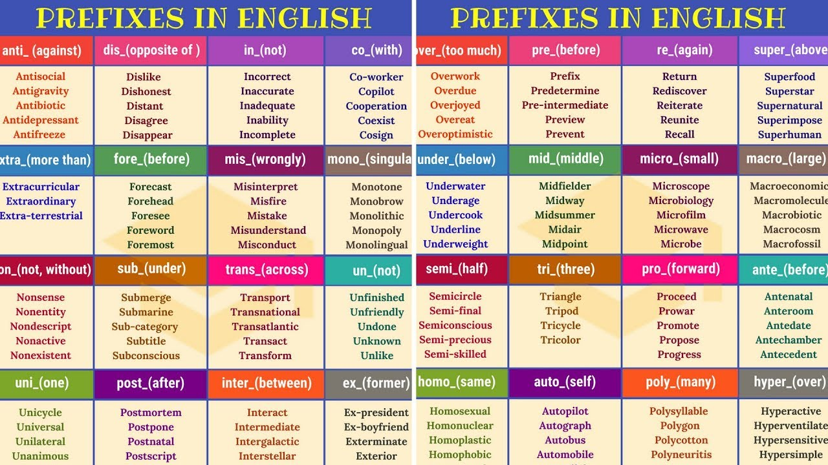

Slide 26

ROOT WORDS

Slide 27
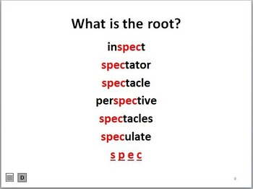

Slide 28
Ego (Latin word )
Ego –I
Egoist
Someone who thinks about oneself only
Selfish

Slide 29
Centric –Latin word - center
Lets us combine these two words
Egocentric
Someone who considers themselves the center of their universe
Extremely selfish ,Self-centered

Slide 30
Mania-obsession
Egomaniac – Someone who is obsessed with oneself .
Egotist - Someone who talks excessively about oneself. Braggart

Slide 31
Verto (Latin word)-to turn
Extrovert- outgoing person (someone who looks outward)
Introvert-A shy person (someone who looks inward)
Ambivert- someone who is both extrovert and introvert
( ambi – Latin word meaning- both.)

Slide 32
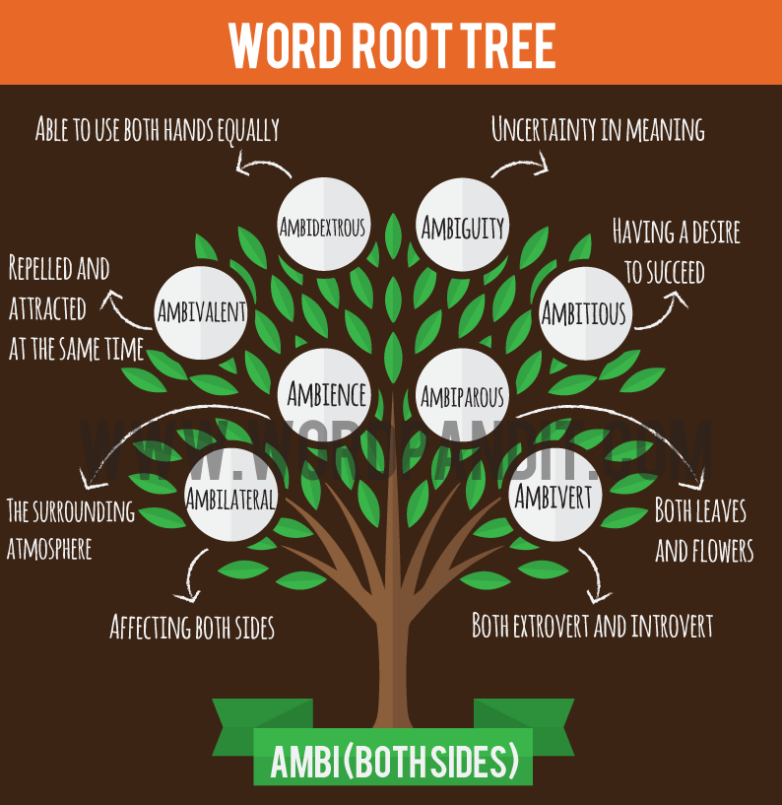

Slide 33
Misein(Greek Word)-to hate
Misanthrope- someone who hates mankind
Misogynist-someone who hates women
Misogamist –someone who hates marriage

Slide 34
Alter (Latin word) -other
Alternative - you skip one and take the other
Alter ego - other self
Altruistic - actions looks towards the benefit of others
Altercation –verbal dispute (You have other ideas ,plans or opinion)

Slide 35
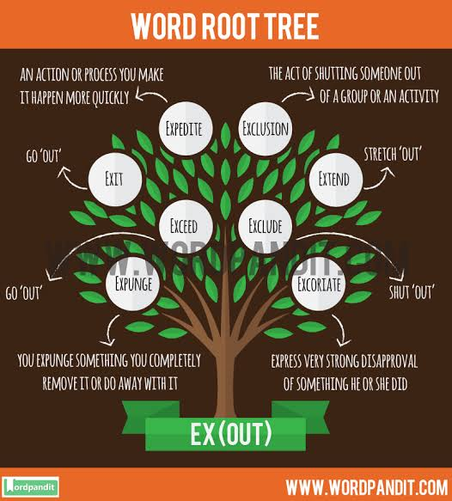

Slide 36
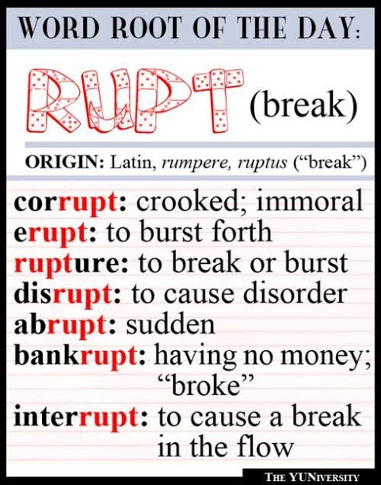

Slide 37
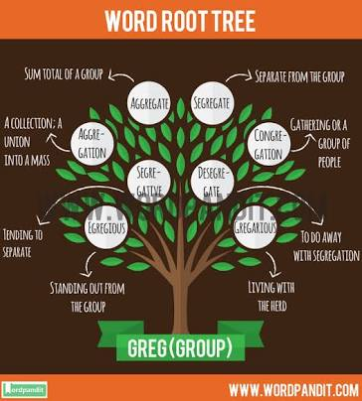

Slide 38
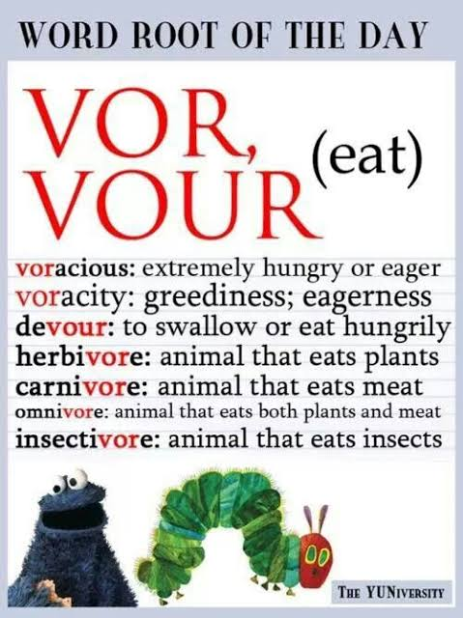

Slide 39
SUFFIX
A suffix is a letter or group of letters added at the end of a word which makes a new word.
Common Suffixes are –tion, -ate, -ible.
Suffixes change the parts of speech of a given word.
Eg : Beauty -> Beautify ->Beautiful -> Beautifully -> Beautician -> Beautification.

Slide 40
Noun Suffix
-acy;
state or quality
-al;
act or process of
-ance/-ence;
state or quality of
-tion;
-ism;
belief
-ity;
quality of
-ment;
condition
-dom;
place or state of being
-er/-or;
one who

Slide 41
Verb Suffixes
-ate
-ify
-ize/-ise
-en

Slide 42
Adjective Suffixes
-able/-ible;
capable of
-ish;
quality
-y;
Characterised by
-ive;
having the nature of
-al;
pertaining to
-ful;
notable
-ic/-ical;
pertaining
-ious;
characterised by
-esque;
reminiscent

Slide 43
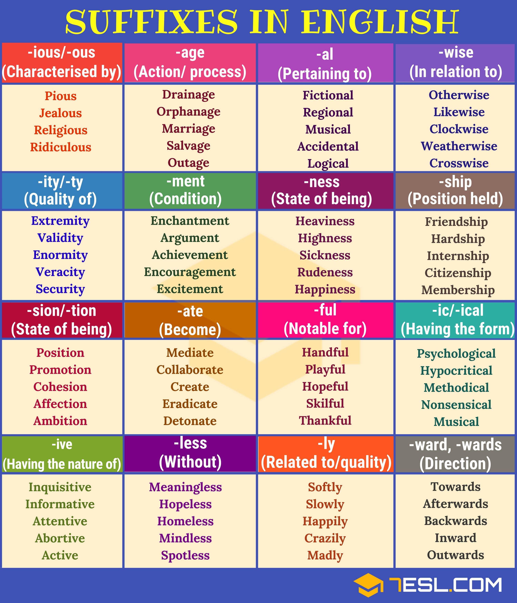

Slide 44
What is the challenge?
The techniques aren’t fool-proof.
They improve your chances of scoring a mark, but don’t guarantee a mark.

Slide 45
Synonyms
Group of words which expresses similar meaning.
(derived from Greek words, syn = same, onyma = a name)
– cute, adorable, gorgeous

Slide 46
Work Sheet- Synonyms
Q.1 Voracious…..
(A) tenacious
(B) truthful
(C) spacious
(D) Ravenous
Q.2 Abortive…..
(A) fruitful
(B) familiar
(C) unsuccessful
(D) consuming

Slide 47
Q.3 Tenacious…..
(A) holding fast
(B) collecting
(C) fast running
(D) Intentional
Q.4 Terse
(A) brief in speech
(B) beyond fear
(C) without honor
(D) under strain

Slide 48
Q.5 Tentative….
(A) mocking
(B) wry
(C) experimental
(D) Prevalent
Q.6 Tenacity…..
(A) ingratitude
(B) decimation
(C) splendor
(D) perseverance

Slide 49
Q.7 Replenish….
(A) reinstale
(B) refill
(C) refuse
(D) Polish
Q.8 Relish….
(A) savor
(B) vindicate
(C) avail
(D) desire

Slide 50
Q.9 Repercussion….
(A) resistance
(B) magnificence
(C) acceptance
(D) Reaction
Q.10 Repellent….
(A) porous
(B) stiff
(C) elastic
(D) unattractive

Slide 51
Q.11 Phlegmatic….
(A) practical
(B) salivary
(C) dishonest
(D) Calm
Q.12 Ponderous….
(A) contemplative
(B) moist
(C) erect
(D) bulky

Slide 52
Q.13 Pinion….
(A) reveal
(B) submit
(C) restrain
(D) express
Q.14 Plagiarism….
(A) theft of funds
(B) theft of ideas
(C) belief in Gods
(D) arson

Slide 53
Q.15 Pinnacle….
(A) pass
(B) taunt
(C) peak
(D) Foothills
Q.16 Nascent….
(A) loyal
(B) treacherous
(C) unnamed
(D) incipient

Slide 54
Q.17 Myopic….
(A) moral
(B) glassy
(C) blind
(D) Nearsighted
Q.18 Monetary…
(A) fiscal
(B) stationary
(C) scrupulous
(D) boring

Slide 55
Q.19 Mundane….
(A) spatial
(B) heretic
(C) worldly
(D) Global
Q.20 Mediocre…..
(A) medieval
(B) industrial
(C) agricultural
(D) average

Slide 56
Q. 21 Distinct
a. satisfied
b. precise
c. uneasy
d. separate
Q.22 Philanthropy
a. selfishness
b. fascination
c. disrespect
d. charity

Slide 57
Q.23 Deplete
a. decorate
b. beg
c. exhaust
d. hurry
Q.24 Spite
a. joy
b. beverage
c. wonder
d . malice

Slide 58
Q.25 Incorrigible
a. happy
b. beyond correction or reform
c. foolish
d. hopeful
Q.26 Disheveled
a. untidy
b. fierce
c. foolish
d. peculiar

Slide 59
Antonyms
An antonym is a word that means the opposite of another given word.
(derived from Greek words, anti = opposite, onym = name)
Eg – Intrinsic and Extrinsic

Slide 60
Work Sheet - Antonyms
Morbid
a. healthy
b. Liberal
c. progressive
d. Stale
Boisterous
a. rowdy
b. tumultuous
c. violent
d. serene

Slide 61
3. Conceit
a. egotistic
b. honest
c. modest
d. vanity
4. Taint
a. cheer
b. worry
c. clean
d. purify

Slide 62
5. Animosity
a. love
b. pious
c. barren
d. hostility
6. Belittle
a. expand
b. prohibit
c. inflate
d. extol

Slide 63
7. Parry A. answer B. ward off C. evasive D. face
8. Copious
A. scanty
B. plenty
C. sufficient
D. scarcity

Slide 64
9. Stingy
a. generous
b. miser
c. careful
d. narrow minded
10. Flaunt
a. regard
b. sink
c. hide
d. propose

Slide 65
11. detain
a. release
b. silence
c. forget
d. prosper
12. famous
a. boring
b. poor
c. obscure
d. untalented

Slide 66
13. colossal
a. easy
b. tiny
c. graceful
d. roof
14. fluid
a. solid
b. liquid
c. afraid
d. decent

Slide 67
15. continue
a. curve
b. argue
c. carry
d. pause
16. labour
a. amuse
b. cat
c. rest
d. strive

Slide 68
17. brawny
a. swift
b. weak
c. strong
d. pale
18. fickle
a. steady
b. kind
c. please
c. finagle

Slide 69
19. inept
a. clumsy
b. infer
c. competent
d. foolish
20. pivotal
a. turning
b. wavy
c. unimportant
d. clear

Slide 70
21. cursed
a. swore
b. pious
c. unfortunate
d. lucky
22. candid
a. unkind
b. blunt
c. valid
d. dishonest

Slide 71
23. flaunt
a. regard
b. sink
c. hide
d. propose
24. heal
a. sew
b. foot
c. good
d. maim

Slide 72
25. pacify
a. excite
b. land
c. coddle
d. unhand
26. sullen
a. dirty
b. cheerful
c. clean
d. risen

